Slide 1
Analyzing Chronic Absenteeism
in Nebraska K–12 Schools | 2020–2021
Exploratory Data Analysis
Team B · DSCI 8950 – Capstone Project
Nilesh Purnekar · Abhinav Adhikari
306,623
63,958
20.9%
Students Enrolled
Chronically Absent
Statewide Rate
Nebraska Department of Education | nde.ne.gov

Slide 2
OVERVIEW
Presentation Roadmap
01
02
03
Introduction
Data Overview
Preprocessing
Context, team & research questions
Sources, structure & variables
Cleaning & feature engineering
04
05
06
Univariate Analysis
Multivariate Analysis
Next Steps & Economic Impact
Individual variable distributions
Cross-variable patterns & FRL relationship
Modeling roadmap & cost of dropouts

Slide 3
INTRODUCTION
Why Chronic Absenteeism Matters
The Problem
Research Questions
Chronic absence = missing ≥10% of the school year (~18+ days)
Directly linked to lower academic achievement & higher dropout risk
Attendance gaps reveal structural socioeconomic disparities
Identifying drivers enables targeted, cost-efficient interventions
Students who drop out earn ~$400K less over a lifetime (US avg)
Nebraska 2020–21 is a COVID-influenced baseline for future analysis
1
How is chronic absenteeism distributed across Nebraska K–12?
2
Do patterns vary by grade level and school type?
3
Which racial/ethnic groups face the highest absence rates?
4
Is FRL% (economic disadvantage) a primary driver?
5
What share of absences are likely to result in dropout — and what does that cost Nebraska?

Slide 4
DATA OVERVIEW
Dataset Description & Sources
Student Absences by District
FRL by District
FRL by School
absenteeism.xlsx (NDE)
frl_district.csv (NDE)
frl_school.xls (NDE)
Statewide aggregate: 6 sheets. District-level absence counts by grade, race, gender, poverty. Key sheet: DISTRICT TOTAL (245 rows × 8 cols).
426 rows × 11 cols. District-level Free & Reduced Lunch counts & FRL%. Used as poverty proxy. Merged with absences on DISTRICT_CODE.
1,201 rows × 11 cols. School-level FRL data with SCHOOLTYPE (Elementary, Middle, High, Secondary). Used for school-type comparisons.
Key Variables
CHRONIC_ABSENT
— Count of students missing ≥10% of year
SCHOOLTYPE
— Elementary / Middle / High / Secondary
FRL_PERCENT
— % students eligible for free/reduced lunch (poverty proxy)
MEMBERSHIP
— Total enrolled per row
DISTRICT_CODE
— Unique district identifier — used as merge key
GRADE_CODE
— Grade PK, KG, 01–12

Slide 5
PREPROCESSING
Data Cleaning & Preprocessing
01
02
Stacked Table Extraction
Merge Key Creation
Attendance Excel has 5 unlabeled stacked tables — each extracted by hardcoded row index (grades 15–27, race 31–37, gender 42–43, poverty 47–48, poverty×race 53–60).
FRL% (frl_district.csv) joined to absences on DISTRICT_CODE. Leading zeros stripped and codes normalized to 9-digit integer keys. Inner join produced 227-row merged dataset.
03
04
Column Standardization
Type Conversion & Rates
All column names stripped, uppercased, spaces replaced with underscores. Membership CSV race codes (F_WH, M_BL…) combined into unified race totals per group.
Raw proportions (e.g. 0.2086) multiplied ×100 for all rate columns. FRL_PERCENT converted to numeric. Masked values ('*') coerced to NaN.
05
06
School Type Mapping
Anomaly Handling
GRADE_CODE strings mapped to level: Elementary (PK–5), Middle (6–8), High School (9–12). SCHOOLTYPE values (ELEMENTARY / SECONDARY) used for school-level analysis.
Poverty-by-race subgroup rates >90% flagged — small sample size artifacts. Excluded from aggregated charts. School-level absenteeism join noted as incomplete (no school-level absence data).

Slide 6
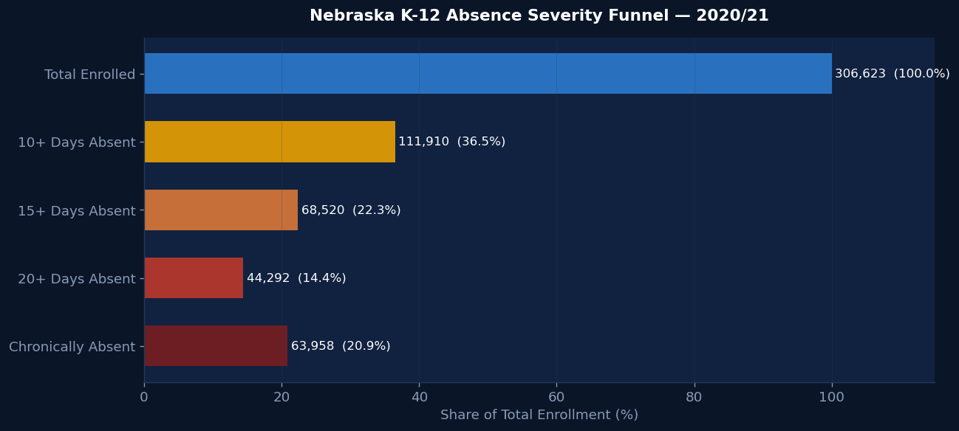
UNIVARIATE ANALYSIS
Statewide Absence Severity — Overview
306,623
111,910
63,958
20.9%
Total Enrolled
10+ Days (36.5%)
Chronically Absent
Statewide Chronic Rate
Source: NDE Student Absences Counts 2020–21 | Chart: Nilesh Purnekar

Slide 7
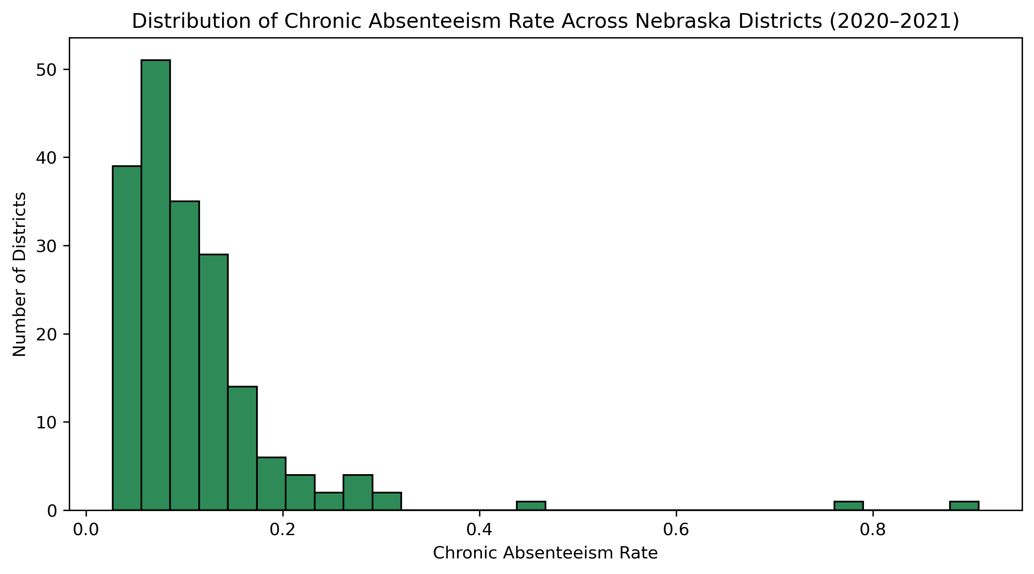
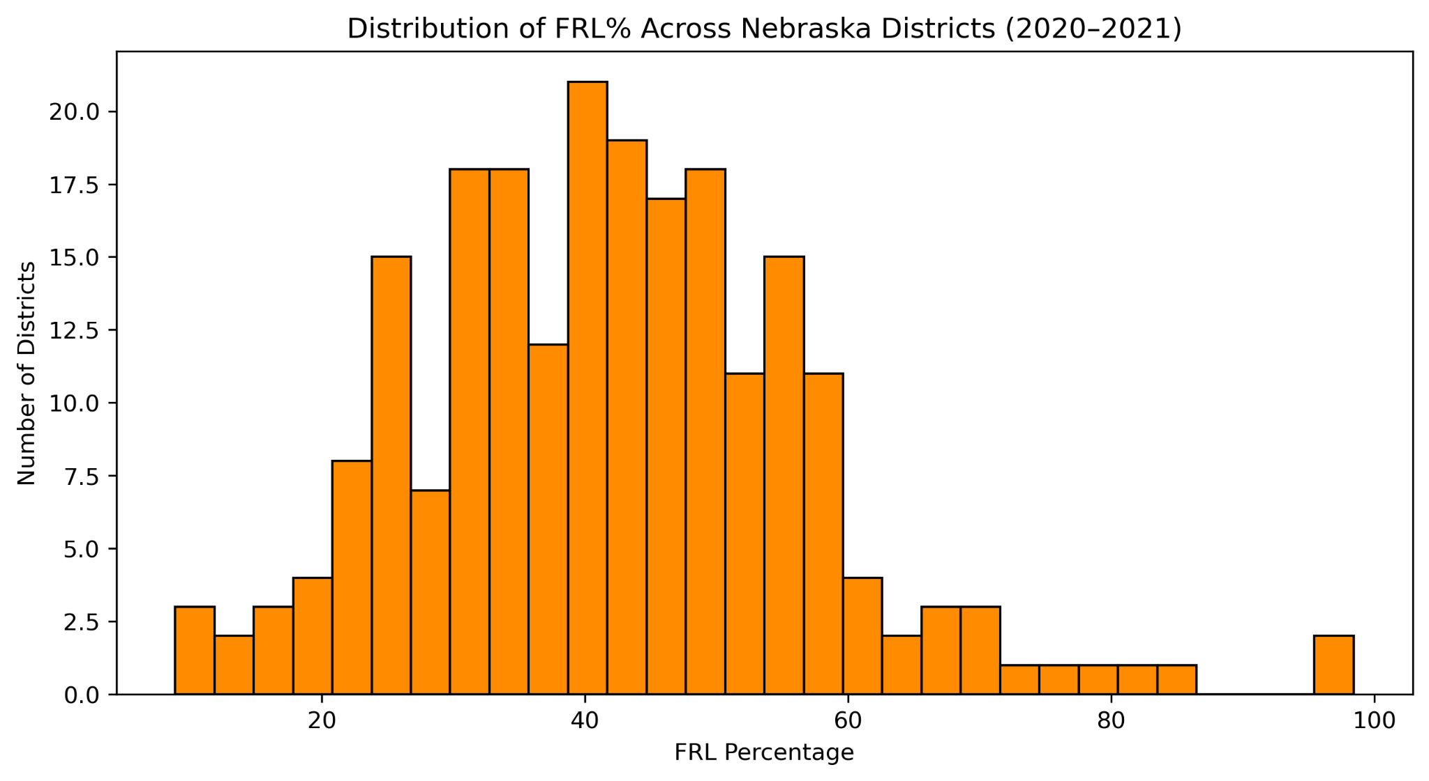
UNIVARIATE ANALYSIS
Distribution of FRL% and Chronic Absent Rate
Chronic Absenteeism Distribution
FRL% Distribution Across Districts
FRL%: mean=42.1%, median=41.5%, range 8.9–98.4% | Chronic rate: mean=11.1%, right-skewed, max=90.8% (outlier)

Slide 8
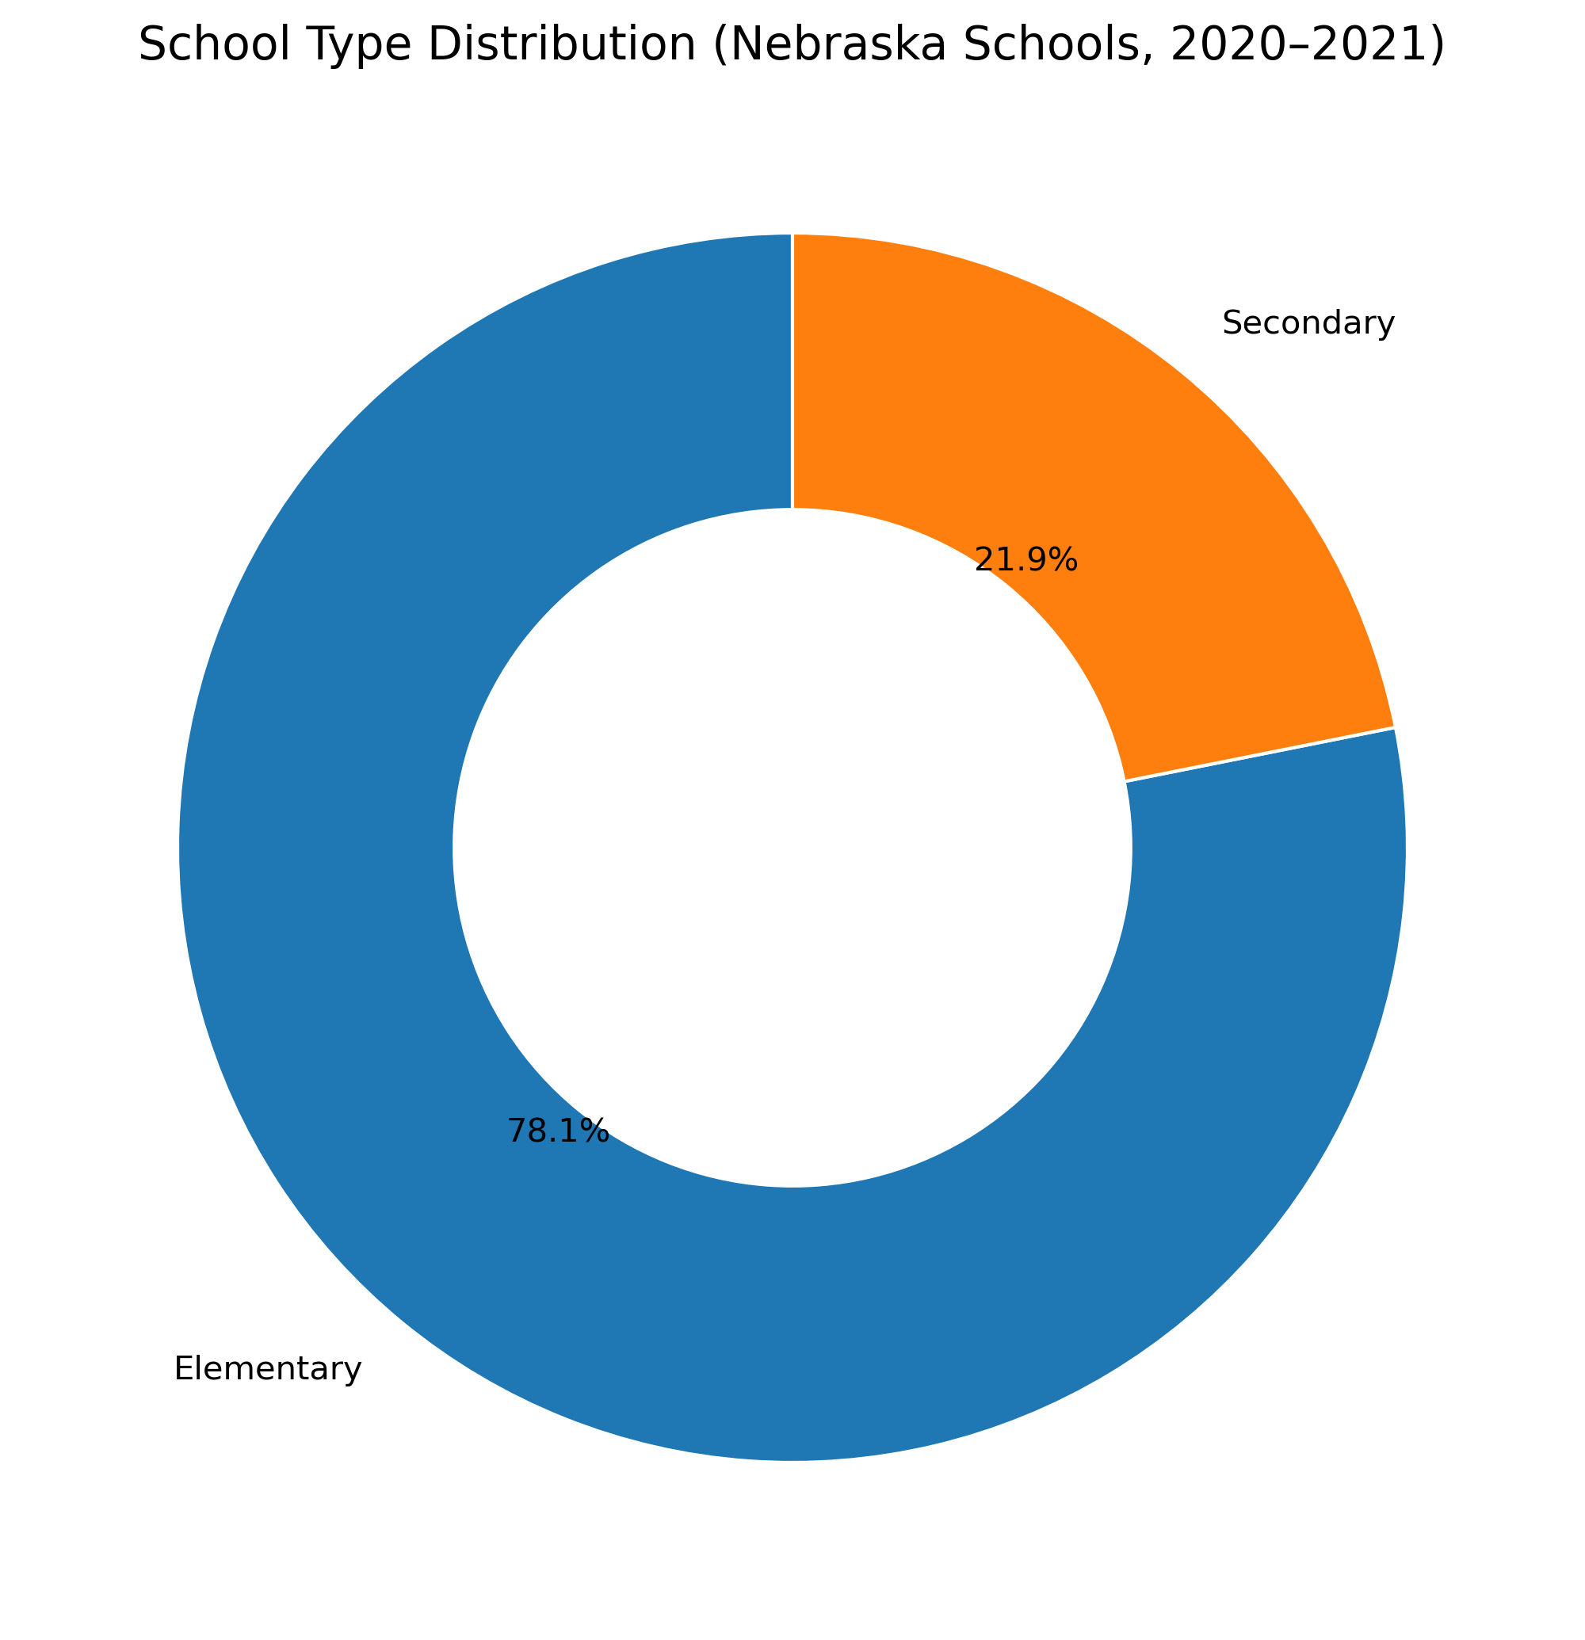
UNIVARIATE ANALYSIS
School Type Distribution
Why School Type Matters
696 Elementary schools (~78%) vs 186 Secondary (~22%)
Dataset is not balanced — elementary schools dominate the sample
Elementary and secondary schools serve very different grade ranges and face different attendance dynamics
Absent rates must be interpreted in the context of level — comparing raw rates across types requires caution
Mean FRL% is similar across elementary and secondary schools — poverty is not isolated to one type
Source: FRL by School dataset (frl_school.xls) — school-level analysis step 9

Slide 9
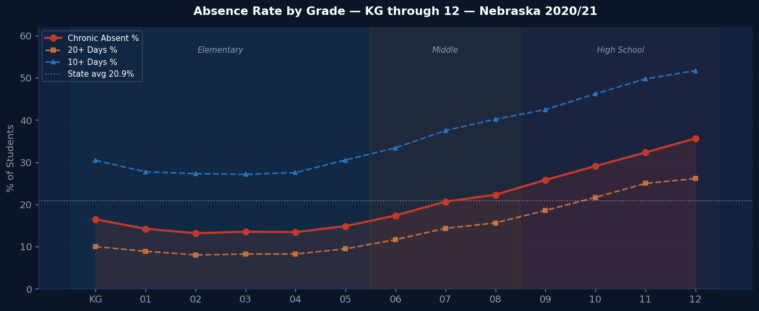
BIVARIATE ANALYSIS
Absenteeism by Grade Level
Grade Insights
35.6%
Grade 12 — peak rate
13.1%
Grade 3 — lowest rate
2.7×
Grade 12 vs Grade 3 ratio
+4.8pp
Grade 8→9 jump (largest)
~14%
Elementary avg
~28%
HS avg
▲ Grade 8→9 transition is the sharpest single-grade escalation — a high-priority intervention window.

Slide 10
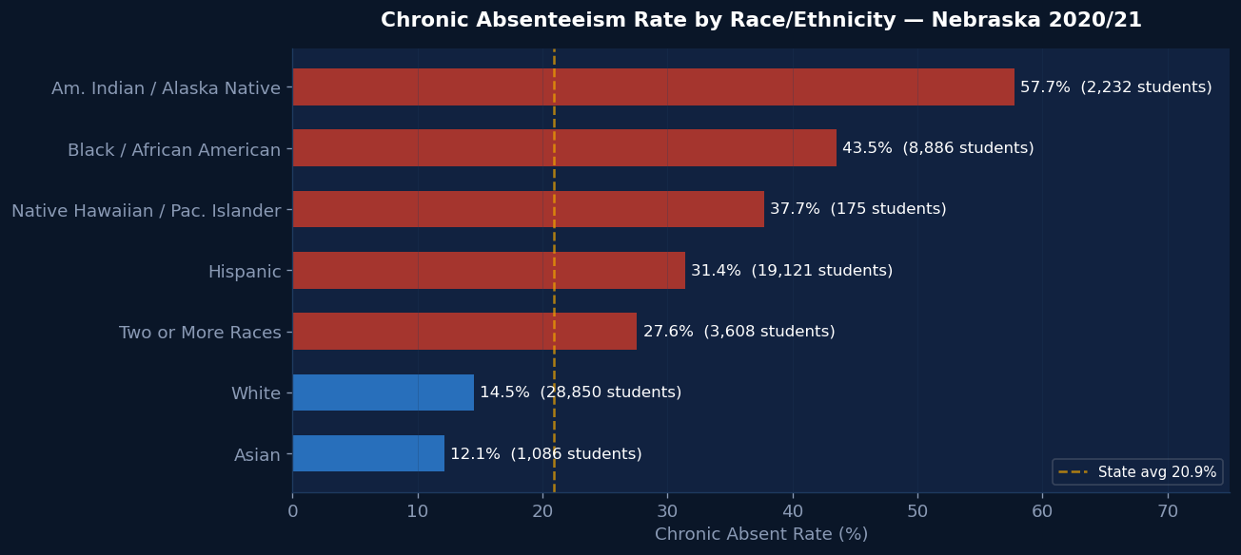
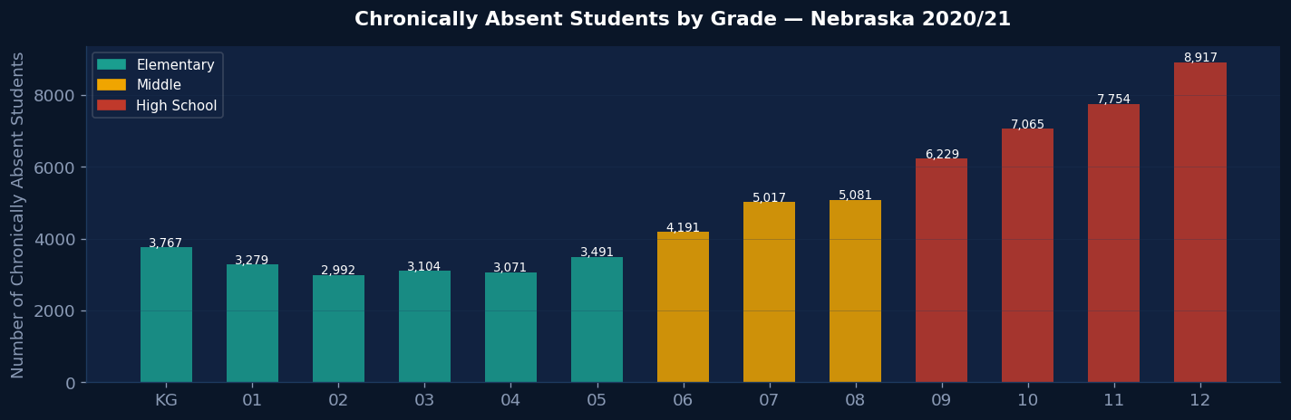
BIVARIATE ANALYSIS
Absenteeism by Race & Tier Escalation
Chronic Rate by Race / Ethnicity
Tier Escalation by Grade
Am. Indian 57.7% — 2.8× state avg
Black 43.5% | Hispanic 31.4%
White 14.5% — but 28,850 students absolute (largest count)
High school grades 9–12 show steepest absolute counts

Slide 11
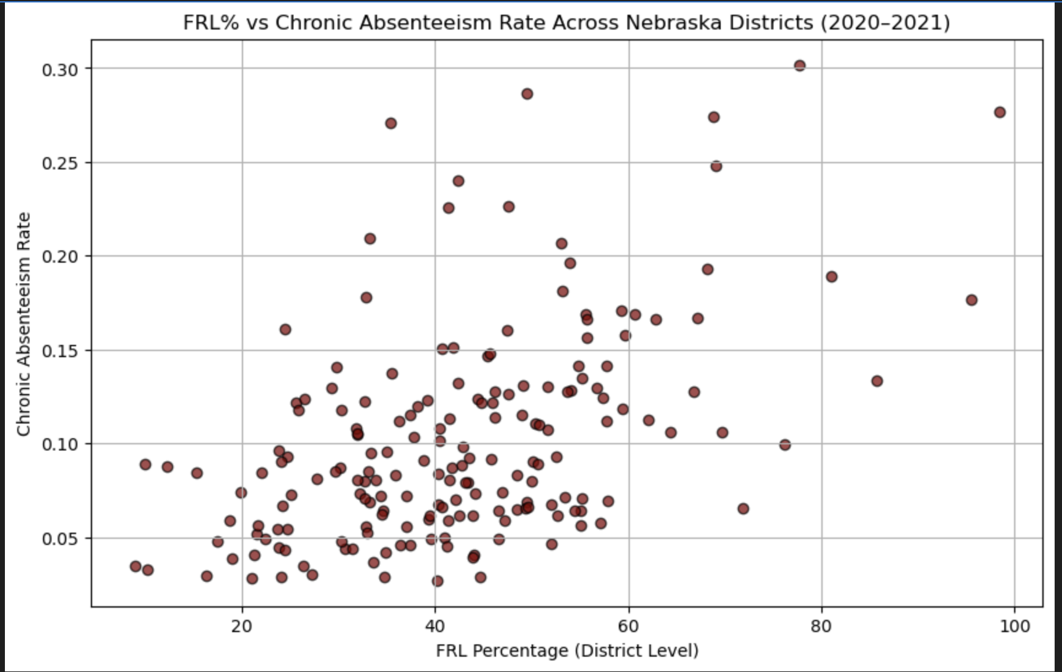
MULTIVARIATE ANALYSIS
FRL% vs Chronic Absenteeism — District Level
Correlation
r = 0.50
Pearson r between FRL% and chronic absent rate
Moderate-to-strong positive relationship
Districts with higher poverty tend to have higher chronic absence
Upward trend is consistent but not perfect — other factors also contribute
227 districts in merged dataset
FRL% is the strongest single continuous predictor available

Slide 12
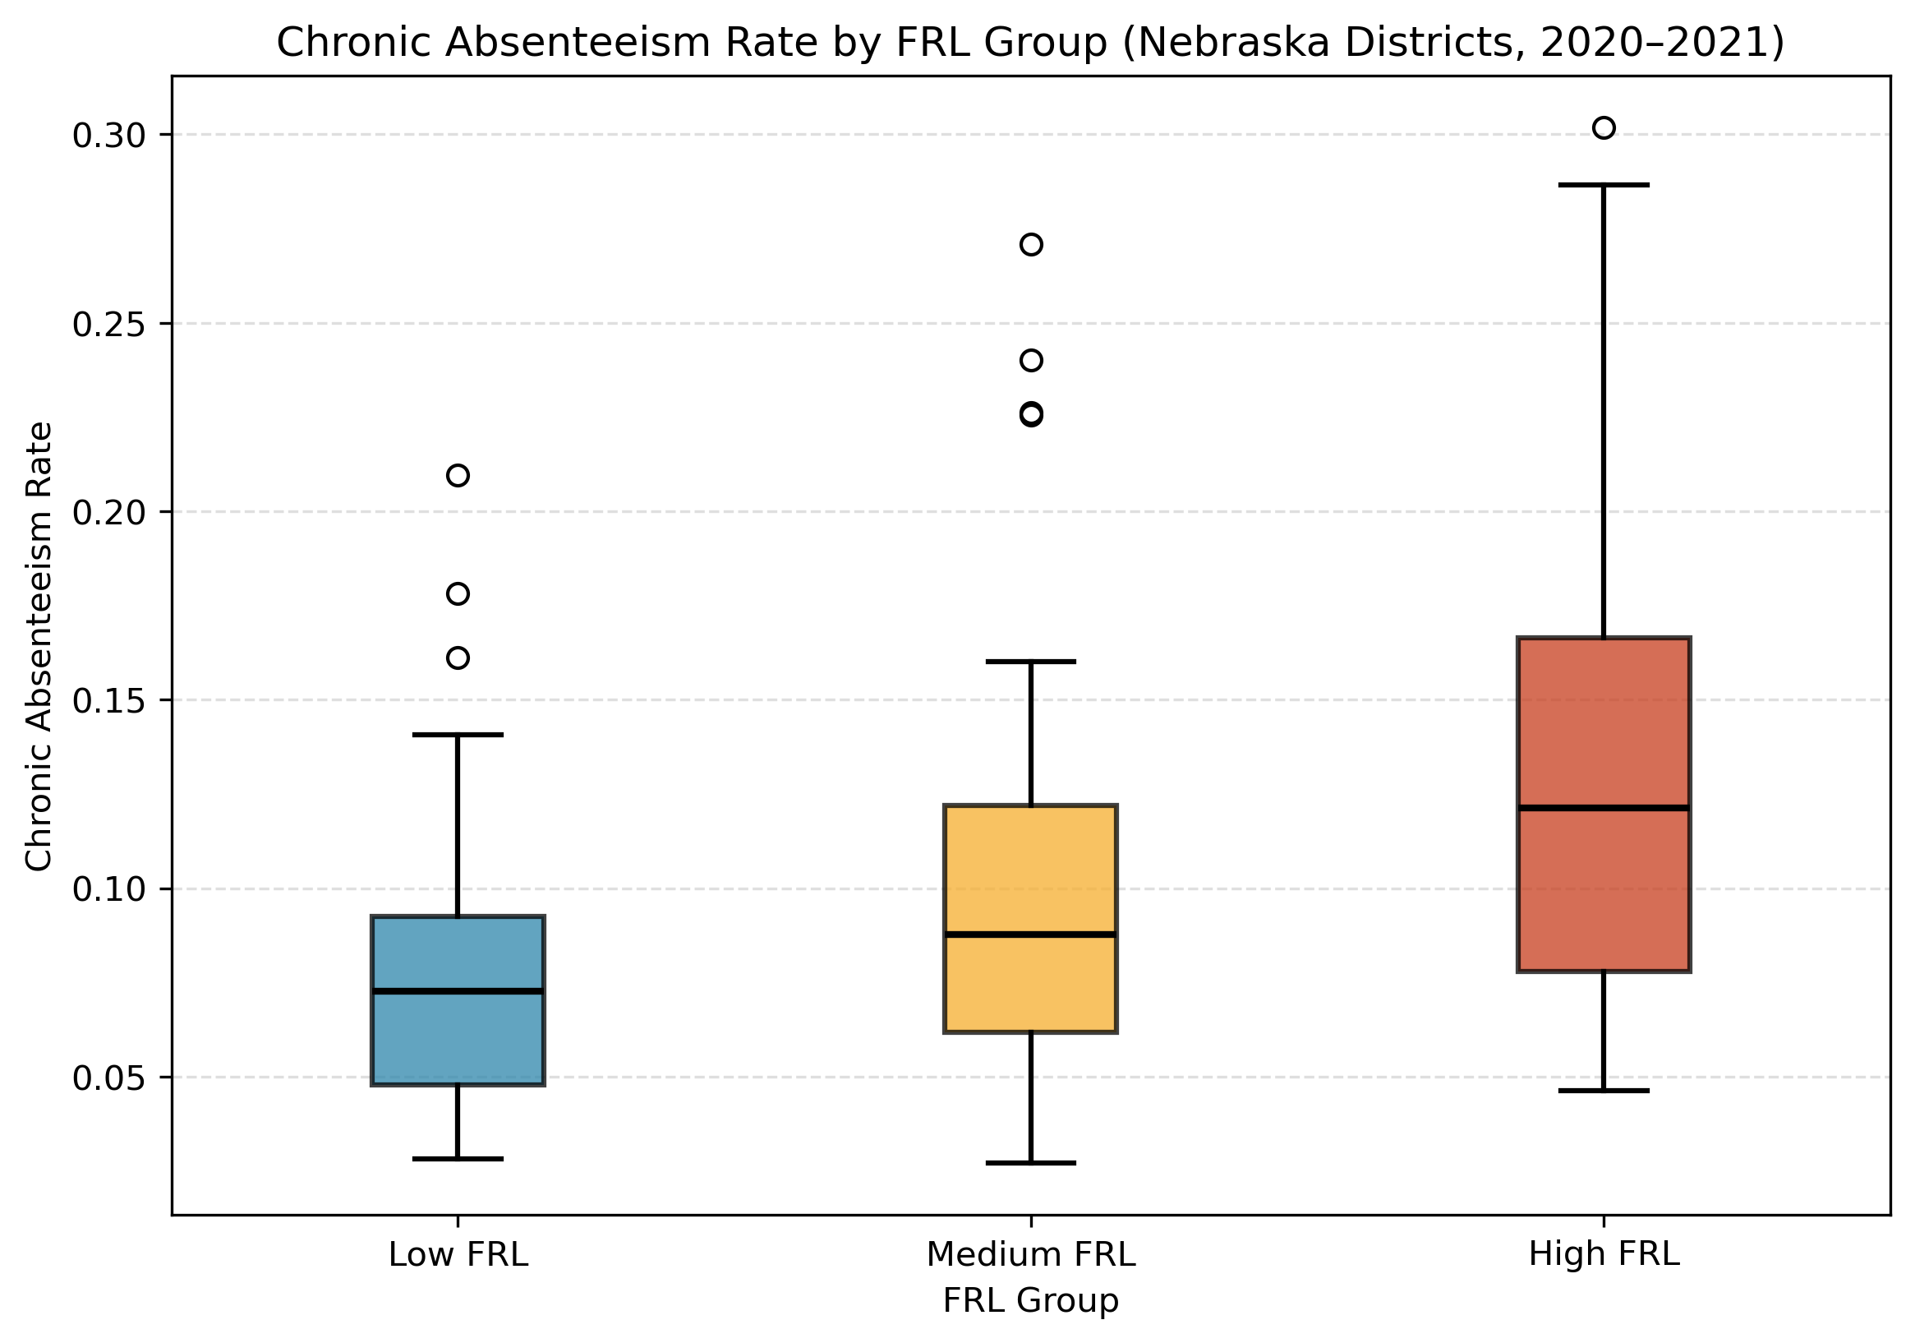
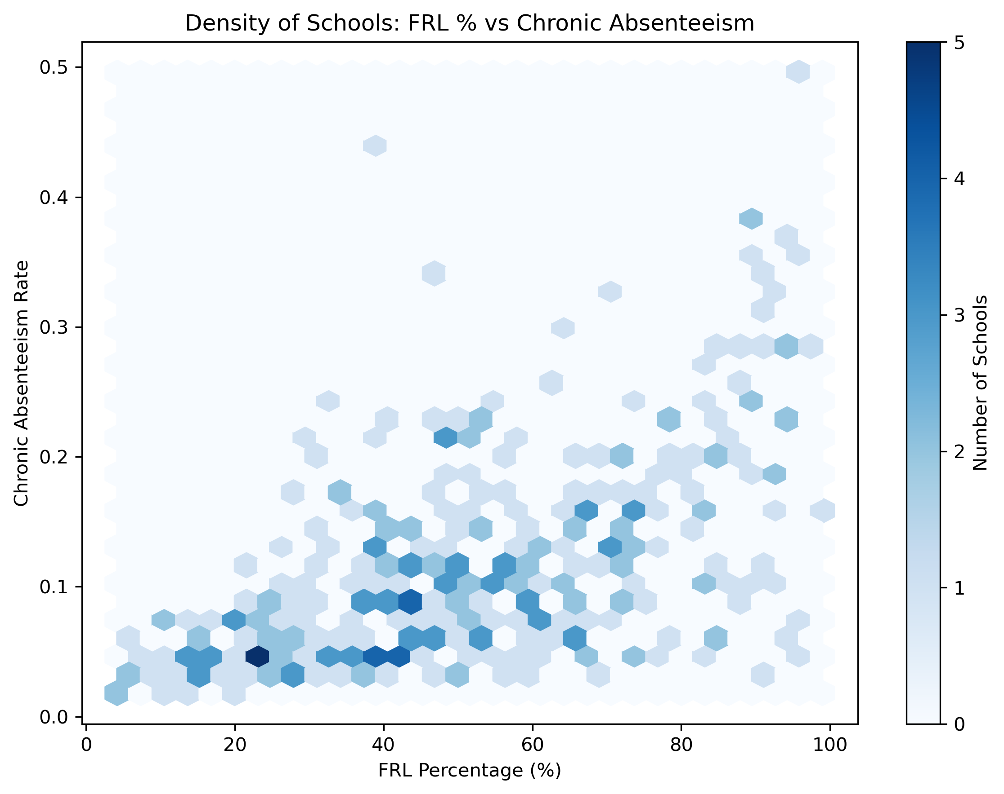
MULTIVARIATE ANALYSIS
FRL Group Comparison & Density
Boxplot — Low / Medium / High FRL
Hexbin Density — FRL% vs Chronic Rate
Boxplot: median chronic rate shifts clearly upward from Low→High FRL. Hexbin: dense cluster at 30–60% FRL, 5–15% chronic rate.

Slide 13
MULTIVARIATE ANALYSIS
Economic Disadvantage & Absenteeism
2.9×
Poverty vs non-poverty chronic rate
(34.7% vs 12.1%)
Context
43.8% of NE students carry a poverty flag
FRL% correlation with chronic rate: r = 0.50
Poverty & race compound independently
FRL% is the strongest single predictor for modeling

Slide 14
LIMITATIONS
Limitations & Challenges
01
02
COVID-Affected Year
No District-Level Join
2020–21 absence rates are elevated vs a typical year. Any year-over-year comparison must account for pandemic disruption.
Attendance file is statewide aggregate only — cannot be merged with membership file at district level. Two datasets tell parallel, not connected, stories.
03
04
No Causal Explanation
No Individual-Level Quantitative Data
Data shows who is absent — not why. Transportation, illness, disengagement, and family circumstances are indistinguishable in this dataset.
Attendance file provides only aggregated counts/percentages. Limited ability to run box plots, histograms, or scatter plots on this file alone without the FRL merge.
05
06
Correlation ≠ Causation
School-Level Merge Incomplete
FRL% r=0.50 is meaningful but not deterministic. Multiple confounders (transportation, housing instability, school culture) are not captured.
No shared school-level ID between absenteeism and FRL school files. School-type analysis could not be merged with absenteeism rates at the school level.

Slide 15
SUMMARY
Key Findings — What the Data Shows
1
1 in 5 students chronically absent
5
Poverty triples chronic risk
63,958 students (20.9%) miss ≥10% of the school year statewide
Poverty students: 34.7% vs non-poverty: 12.1% (2.9× ratio)
2
Absence nearly doubles K–12
6
Stark racial disparities
Grade 3 low of 13.1% → Grade 12 high of 35.6%
Am. Indian 57.7%, Black 43.5% vs White 14.5%, Asian 12.1%
3
Grade 8→9 is the key escalation
7
Gender is a null finding
Largest single-grade jump — highest-ROI intervention window
Female 20.8% ≈ Male 20.9% — strengthens significance of other findings
4
FRL% is the strongest predictor
8
Elementary schools dominate count
r=0.50 correlation; high-FRL districts show 3× the chronic rate of low-FRL
~78% of schools are elementary — sample composition matters for comparisons

Slide 16
NEXT STEPS
Modeling & Intervention Roadmap
Phase 1
Phase 2
Phase 3
Phase 4
Data Enrichment
Predictive Modeling
Intervention Targeting
Economic Impact Report
Obtain district-level absence data to enable full join with FRL & membership files
Build classification model for high-risk district identification
Prioritize Grade 6–9 transition programs — highest-ROI window in data
Link NDE per-pupil expenditure to absence counts for funding loss estimates
Add continuous FRL% to all aggregated tables (currently binary poverty flag only)
Features: FRL%, race composition, grade distribution, school type
Target Am. Indian + poverty and Black + poverty subgroups first
Model dropout probability from chronic absenteeism rates by grade
Source NDE graduation & dropout rates by grade and race for pipeline analysis
Compare logistic regression, decision tree, and gradient boosting
Focus metro resources: Douglas & Lancaster counties drive statewide numbers
Quantify lifetime earnings loss and lost state tax revenue (see next slide)

Slide 17
ECONOMIC IMPACT
The Cost of Chronic Absenteeism to Nebraska
Chronic absenteeism is strongly linked to dropout. Our next phase will build a report quantifying how much Nebraska loses when chronically absent students fail to complete school.
01
02
03
Dropout Risk Pathway
Lifetime Earnings Loss
State Revenue Impact
Chronic absence → increased dropout risk
High school dropout earns ~$28,000/yr vs ~$40,000/yr for a diploma holder
Nebraska income tax rate ~5.84% (flat, 2024)
~15–20% of chronically absent students do not graduate on time (national research)
Lifetime gap: ~$400,000 per dropout (Census Bureau, 2023)
$400K lifetime gap × 5.84% = ~$23,360 in lost state taxes per dropout
63,958 chronically absent NE students × 17% estimated dropout rate = ~10,900 at-risk students per cohort
10,900 at-risk students × $400K = ~$4.36 billion lifetime earnings at stake per cohort
10,900 dropouts × $23,360 = ~$255 million in projected lost state revenue per cohort
Estimates based on: US Census Bureau (2023), NDE per-pupil data, Nebraska DOR tax rate. Cohort = one year's chronically absent students.

Slide 18
ECONOMIC IMPACT
Economic Impact Report: Scope & Data Plan
~$255M
~10,900
~$4.4B
Projected lost NE state revenue per cohort
At-risk students per cohort (17% of 63,958)
Lifetime earnings at stake per cohort
Data Sources Needed
Report Sections Planned
NDE: Annual dropout rates by district, grade, and race
US Census Bureau: Nebraska median earnings by education level
Nebraska DOR: Current income tax schedule
NDE: Per-pupil state aid formula (attendance-based funding)
BLS: Nebraska labor force participation by education level
Section 1: Who is chronically absent & likely to drop out (by race, grade, poverty)
Section 2: Per-student and statewide lifetime earnings loss
Section 3: Lost state income tax revenue projections (10yr, 20yr, lifetime)
Section 4: ROI of intervention — cost to reduce absenteeism vs revenue saved
Goal: provide Nebraska policymakers a dollar figure for the cost of inaction on chronic absenteeism.

Slide 19
Thank You
Questions & Discussion
The one-sentence summary:
"In 2020–21, 1 in 5 Nebraska K–12 students was chronically absent — with poverty and race amplifying that risk by nearly 3×, and an estimated $255M in state revenue at stake per graduating cohort."
Team B | DSCI 8950 Capstone | Nebraska Dept of Education 2020–21
Nilesh Purnekar · Abhinav Adhikari
Source: NDE Data & Information Archives | nde.ne.gov

